Slide 1

Introduction to
Alfresco Process Services

Slide 2
Table of Contents
BPM Introduction
Alfresco Process Services Overview
APS Architecture
BPMN 2.0 Introduction
BPMN 2.0 Components
APS Installation and configuration

Slide 3
BPM Introduction
What is a “Process?”
A process is “a collection of interrelated work tasks initiated in response to an event that achieves a specific result”.
What is “Business Process Management”?
BPM is a way of looking at and then controlling the processes that are present in an organization.
3

Slide 4
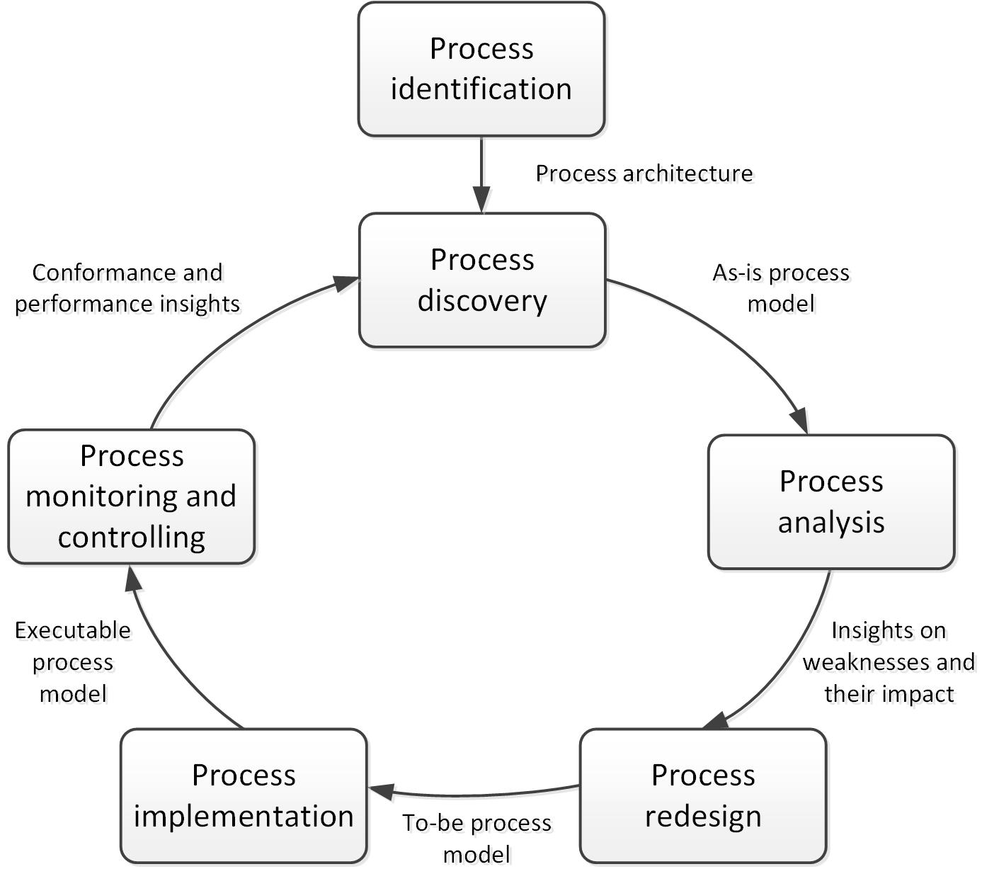
BPM Introduction
Lifecycle of Business Process
4

Slide 5
BPM Introduction – Process Modelling
What is Process Modelling?
The capturing of an ordered sequence of business activities and supporting information.
Business processes describe how a business pursues its objectives
There are different levels of process modeling:
Process Maps – simple flow charts of the activities
Process Descriptions – flow charts extended with additional information, but not enough to fully define actual performance
Process Models – flow charts extended with enough information so that the process can be analyzed, simulated, and/or executed
5

Slide 6
BPM Introduction
Business Process Modeling Techniques
Business process modeling notation (BPMN)
UML diagrams
Flowchart technique
Data flow diagrams
Role activity diagrams
Role interaction diagrams
Gantt charts
Integrated definition for function modeling
Colored petri-nets
Object oriented methods
Workflow technique
Simulation model
6
Notes:
Business process modeling is mainly used to map a workflow so you can understand, analyse and make positive changes to that workflow or process. Usage of diagram helps you to visualize this process and make better decisions.

Slide 7
Alfresco Process Services Overview
Alfresco Process Services (powered by Activiti) is an enterprise Business Process Management (BPM) solution targeted at business people and developers.
At its core is a high performance open-source business process engine based on Activiti with the flexibility and scalability to handle a wide variety of critical processes.
Alfresco Process Services provides a powerful suite of end user tools and integrates with a range of enterprise systems, including Alfresco Content Services, Box and Google Drive.

Slide 8
Alfresco Process Services Overview (contd.)
Activiti is an open source BPMN process engine implemented in Java that can be used to design, implement, deploy, and run workflows.
Activiti was created in 2010 by Tom Baeyens and Joram Barrez, both coming from JBoss where they were developing the jBPM workflow engine.
Problem with jBPM is that it did not support the new workflow definition standard called BPMN 2.0.
Alfresco employ both Tom and Joram to build Alfresco Activiti open source workflow engine.
Alfresco Process Services was born in 2014 to support features such as scalability, management, reporting, advanced design tools etc.
Alfresco Process Services core workflow engine is the Apache licensed open source product that runs BPMN 2.0 workflow definitions.

Slide 9
Alfresco Process Services Features
Process Designer - step based process designer for the end-user, DMN compliant decision tables, sharing of applications, models, stencil sets, export/import of applications, forms, models, and stencil sets, auto document generation.
User Task Management - group task lists, dynamic form attachments, MS Office document preview, localized UI
Form Design - forms library, multi-tab forms, rich form controls, data driven controls (REST), support for conditional visibility
Process Analytics - process heat maps, process summary reports, task performance reports, SLA reports
System Administration - Admin UI for process engine configuration and cluster farm configuration, LDAP and AD sync, multi-tenant support
Application Integration - Alfresco One ECM, Box and Google Drive, SharePoint

Slide 10
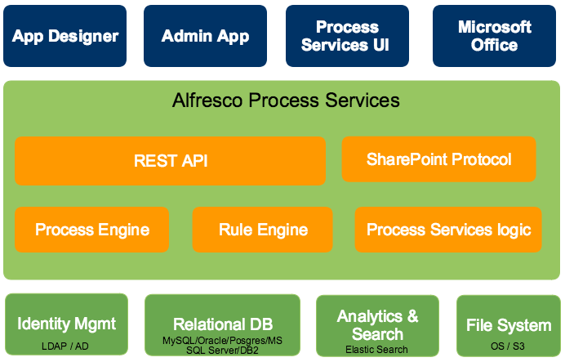
Alfresco Process Services Architecture

Slide 11
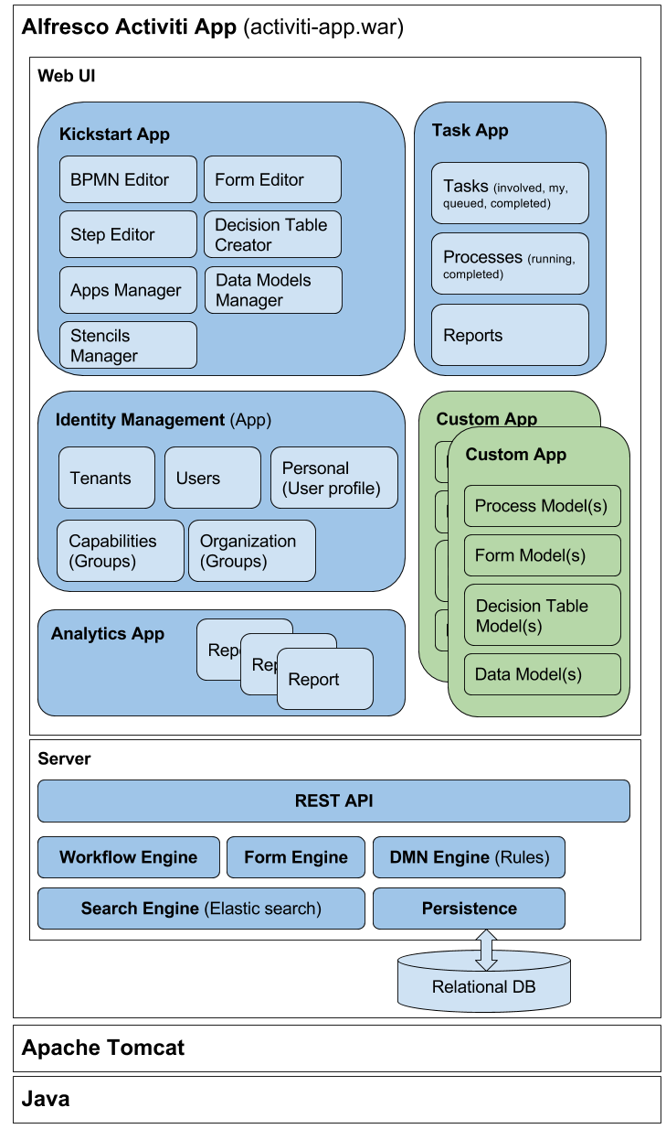
Alfresco Process Services Architecture

Slide 12
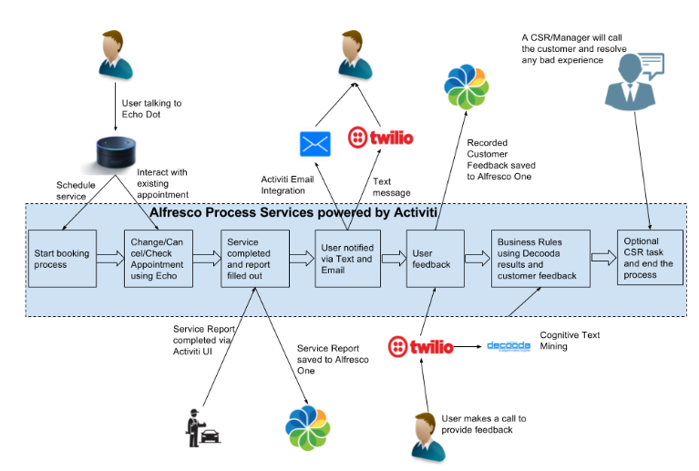
Alfresco Process Services Sample Use case
Notes:
Echo Dot is a hands-free, voice-controlled device that uses the same far-field voice recognition as Amazon Echo. Dot has a small built-in speaker—it can also connect to your speakers over Bluetooth or with the included audio cable.
Twilio is a developer platform for communications. It provides Messaging API and SDKs to send and receive SMS, MMS, and IP messages globally from your web and mobile app, and use intelligent delivery features to ensure messages get through.
It also provides Voice API and SDKs to build calling capabilities within web and mobile apps. Connect to landlines, mobile devices or even WebRTC clients to make calls from apps or power multinational call centers.
Decooda’s Cognitive Intelligence Machine is a text analytics engine that has been built on top of Decooda’s Liquid Data Platform.

Slide 13
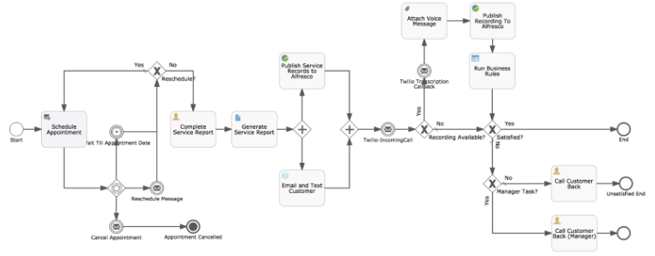
Alfresco Process Services Sample Use case
BPMN representation

Slide 14
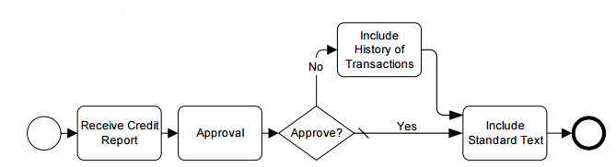
BPMN 2.0 Overview
BPMN is flow-chart based notation for defining Business Processes.
BPMN is an agreement between multiple modeling tools vendors, who had their own notations, to use a single notation for the benefit of end-user understand and training.
BPMN provides a mechanism to generate an executable Business Process (BPEL) from the business level notation
Business Process Model and Notation version 2.0 is a standard for defining workflows that is managed by Object Management Group (OMG).
It covers both the graphical representation (shapes and XML serialization of diagram) and the process definition (XML serialization) used to execute the process.
14

Slide 15
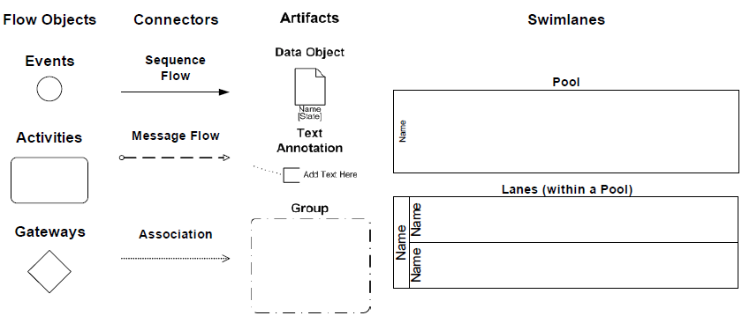
BPMN 2.0 Concepts
Basic components of BPMN 2.0 are:
Flow Objects
Connector objects
Artifacts
Swimlanes
15

Slide 16
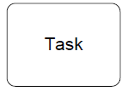
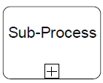
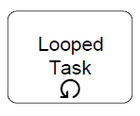






BPMN 2.0 Concepts - Activities
An Activity is represented by a rounded-corner rectangle.
An activity is work that is performed within a business
process.
An activity can be atomic (tasks) or non-atomic (compound/sub-process).
The types of activities that are a part of a Process Model are: Sub-Process, and Task
They can be performed once or can have internally defined loops
16

Slide 17

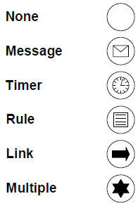
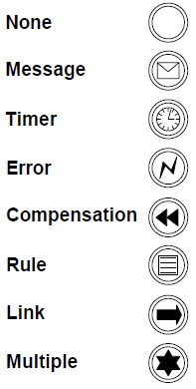
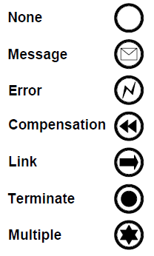
BPMN 2.0 Concepts - Events
An Event is something that “happens” during the course of a business process.
These Events affect the flow of the Process and usually have a trigger or a result.
They can start, interrupt, or end the flow
Events are circles. The type of boundary determines the type of Event.
Start Events indicate where a Process
will begin.
Intermediate Events occur after a process has been started and before a process is ended.
End Events indicates where a process will end.
17

Slide 18
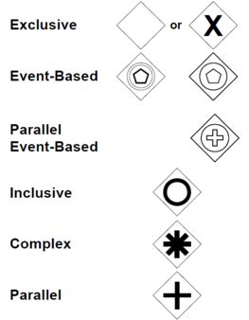
BPMN 2.0 Concepts - Gateways
Gateways are modeling elements that are used to control how Sequence Flows interact as they converge and diverge within a Process.
All types of Gateways are diamonds
All Gateways both split and merge the flow
18

Slide 19
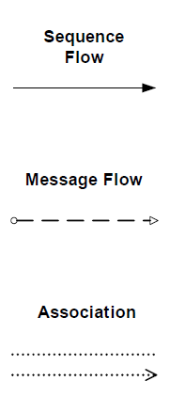
BPMN 2.0 Concepts - Connectors
A Sequence Flow is used to show the order that activities will be performed in a Process
A Message Flow is used to show the flow of messages between two entities that are prepared to send and receive them
An Association is used to associate data, information and artifacts with flow objects
19

Slide 20
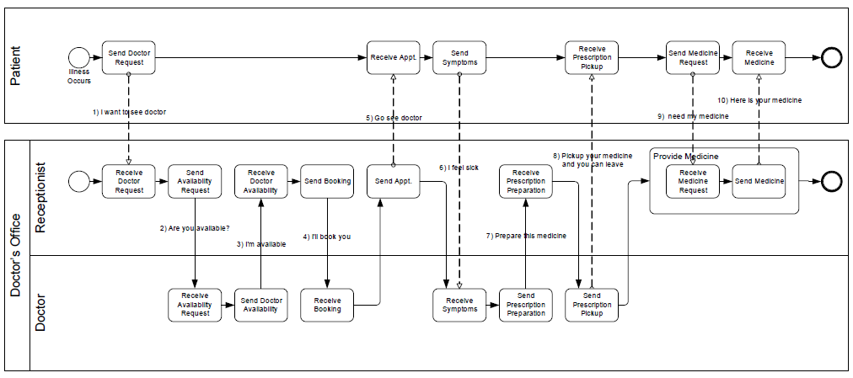
BPMN 2.0 Concepts - Swimlanes
BPMN uses the concept known as “swimlanes” to help partition and/organize activities.
There are two main types of swimlanes: Pool and Lane
Pools represent Participants in an interactive (B2B) Business Process Diagram
Lanes represent sub-partitions for the objects within a Pool
20

Slide 21
Alfresco Process Services Installation
Demo

Slide 22
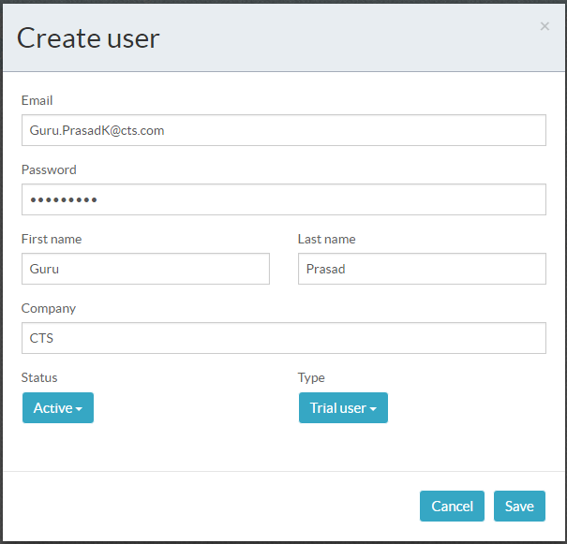
User creation

Slide 23
Thank you

